Slide 1
Hubs, Bridges and Switches (4.7.5)
WEEK 3

Slide 2
Interconnecting LANs
Q: Why not just one big LAN?
Limited amount of supportable traffic: on single LAN, all stations must share bandwidth
limited length: 802.3 (Ethernet) specifies maximum cable length
large “collision domain” (can collide with many stations)
limited number of stations: 802.5 (token ring) have token passing delays at each station
(A t in a hostel)
A postman for the whole country

Slide 3
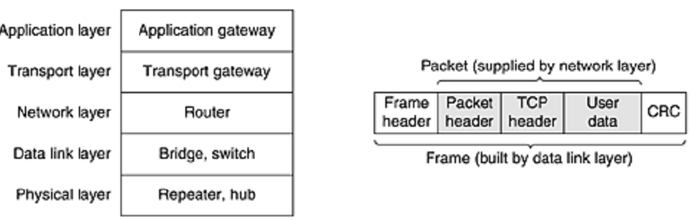
Many devices are available for LAN’s interconnection.
They work on different layers.
The layer matters because different devices use different pieces of information to decide how to switch.
cyclic redundancy check (CRC)

Slide 4
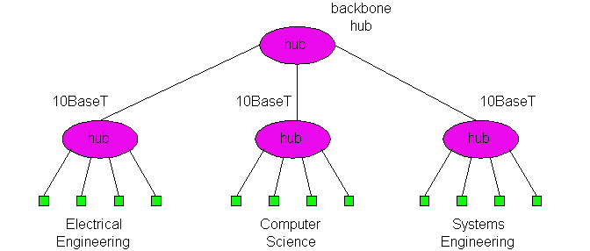
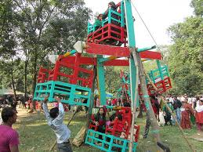
Repeater/Hub
Amplify / do not amplify
Repeaters do not understand frames, packets, or headers. They understand Volts
Classic Ethernet, for example, was designed to allow four repeaters, in order to extend the maximum cable length from 500 meters to 2500 meters.
Hubs can be arranged in a hierarchy (or multi-tier design), with backbone hub at its top

Slide 5
Hubs (more)
Each connected LAN referred to as LAN segment
Hubs do not isolate collision domains: node may collide with any node residing at any segment in LAN
Hub Advantages:
simple, inexpensive device
Multi-tier provides graceful degradation: portions of the LAN continue to operate if one hub malfunctions
extends maximum distance between node pairs (100m per Hub)

Slide 6
Bridges
Link Layer devices: operate on Ethernet frames, examining frame header and selectively forwarding frame based on its destination
Bridge isolates collision domains since it buffers frames
When frame is to be forwarded on segment, bridge uses CSMA/CD to access segment and transmit

Slide 7
Like a hub, a modern bridge has line cards, usually for four or eight input lines of a certain type.
A line card for Ethernet cannot handle, say, token ring frames, because it does not know where to find the destination address in the frame header.
However, a bridge may have line cards for different network types and different speeds.
With a bridge, each line is its own collision domain, in contrast to a hub.

Slide 8
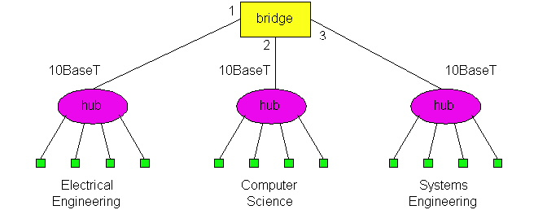
Backbone Bridge

Slide 9
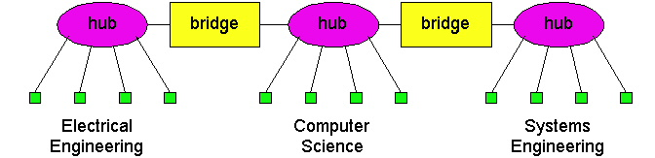
Interconnection Without Backbone
Not recommended for two reasons:
- single point of failure at Computer Science hub
- all traffic between EE and SE must path over CS segment

Slide 10
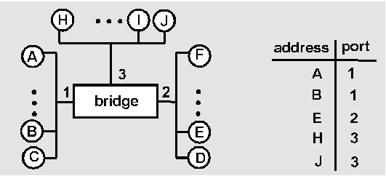
Bridge Learning: example
Suppose C sends frame to D and D replies back with frame to C
C sends frame, bridge has no info about D, so floods to both LANs
bridge notes that C is on port 1
frame ignored on upper LAN
frame received by D

Slide 11
Bridge Learning: example
C 1
D generates reply to C, sends
bridge sees frame from D
bridge notes that D is on interface 2
bridge knows C on interface 1, so selectively forwards frame out via interface 1

Slide 12
What will happen with loops? Incorrect learning
B
2
2
A , 1
A , 1
2
2
1
1
A

Slide 13
Loop-free: tree
C
B
A message from A will mark A’s location
A

Slide 14
Loop-free: tree
C
B
A: ↓
A message from A will mark A’s location
A

Slide 15
Loop-free: tree
A: ↓
C
B
A: ↓
A message from A will mark A’s location
A

Slide 16
Loop-free: tree
A: →
A: ←
A: ↓
C
B
A: ←
A: ↓
A message from A will mark A’s location
A

Slide 17
Loop-free: tree
A: →
A: ←
A: ↓
C
B
A: ←
A: ↓
A message from A will mark A’s location
A

Slide 18
Loop-free: tree
A: →
A: ←
A: ↓
C
B
A: ←
A: ↓
So a message to A will go by marks…
A message from A will mark A’s location
A

Slide 19
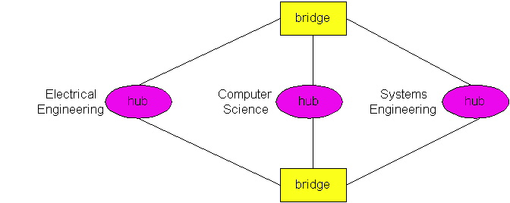
Bridges Spanning Tree
for increased reliability, desirable to have redundant, alternative paths from source to dest
with multiple paths, cycles result - bridges may multiply and forward frame forever
solution: organize bridges in a spanning tree by disabling subset of interfaces
Disabled

Slide 20
Introducing Spanning Tree
Allow a path between every LAN without causing loops (loop-free environment)
Bridges communicate with special configuration messages (BPDUs)
Standardized by IEEE 802.1D

Slide 21
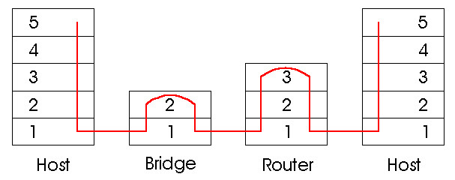
Bridges vs. Routers
both are store-and-forward devices
routers: network layer devices (examine network layer headers)
bridges are Link Layer devices
routers maintain routing tables, implement routing algorithms
bridges maintain filtering tables, implement filtering, learning and spanning tree algorithms

Slide 22
Routers vs. Bridges
Bridges + and -
+ Bridge operation is simpler requiring less processing
- Topologies are restricted with bridges: a spanning tree must be built to avoid cycles
- Bridges do not offer protection from broadcast storms (endless broadcasting by a host will be forwarded by a bridge)

Slide 23
Routers vs. Bridges
Routers + and -
+ arbitrary topologies can be supported, cycling is limited by TTL counters (and good routing protocols)
+ provide firewall protection against broadcast storms
- require IP address configuration (not plug and play)
- require higher processing
bridges do well in small (few hundred hosts) while routers used in large networks (thousands of hosts)

Slide 24
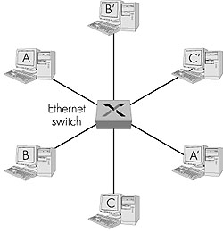
Ethernet Switches
layer 2 (frame) forwarding, filtering using LAN addresses
Switching: A-to-B and A’-to-B’ simultaneously, no collisions
large number of interfaces
often: individual hosts, star-connected into switch
Ethernet, but no collisions!

Slide 25
Ethernet Switches
cut-through switching: frame forwarded from input to output port without awaiting for assembly of entire frame
slight reduction in latency
combinations of shared/dedicated, 10/100/1000 Mbps interfaces

Slide 26
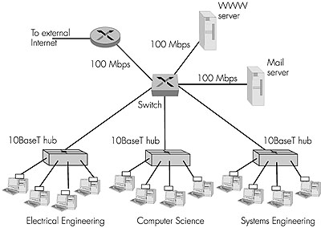
Ethernet Switches (more)
Dedicated
Shared

Slide 27
Switches are similar to bridges in that both route on frame addresses.
In fact, many people uses the terms interchangeably.
The main difference is that a switch is most often used to connect individual computers

Slide 28
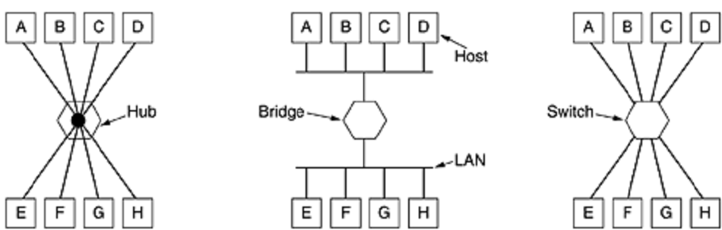
when host A in Fig.(mid) wants to send a frame to host B, the bridge gets the frame but just discards it.
In contrast, in Fig.(right), the switch must actively forward the frame from A to B because there is no other way for the frame to get there.

Slide 29
Since each switch port usually goes to a single computer, switches must have space for many more line cards than do bridges intended to connect only LANs.
Each line card provides buffer space for frames arriving on its ports.
Since each port is its own collision domain, switches never lose frames to collisions.
However, if frames come in faster than they can be retransmitted, the switch may run out of buffer space and have to start discarding frames.

Slide 30
FDDI
Fiber Distributed Data Interface (FDDI) is a standard for data transmission in a local area network.
It uses optical fiber as its standard underlying physical medium, although it was also later specified to use copper cable, in which case it may be called CDDI (Copper Distributed Data Interface), standardized as TP-PMD (Twisted-Pair Physical Medium-Dependent), also referred to as TP-DDI (Twisted-Pair Distributed Data Interface).

Slide 31
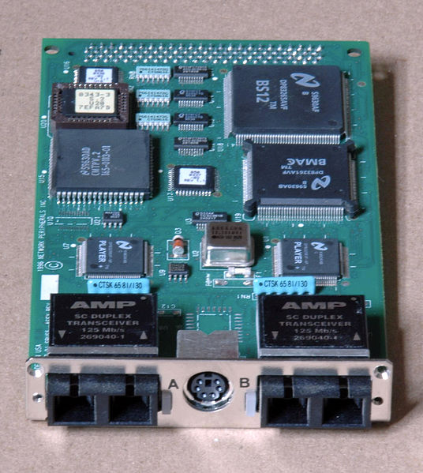
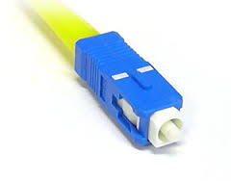
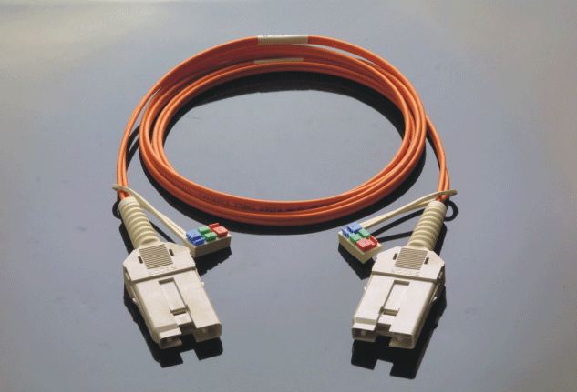
SC connector
Dual-attach sbus FDDI card with SC connectors and a DIN (DC power connector) for an external optical bypass unit.

Slide 32
FDDI provides a 100 Mbit/s optical standard for data transmission in local area network that can extend in range up to 200 kilometers (120 mi).
Although FDDI logical topology is a ring-based token network, it did not use the IEEE 802.5 token ring protocol as its basis;
instead, its protocol was derived from the IEEE 802.4 token bus timed token protocol

Slide 33
In addition to covering large geographical areas, FDDI local area networks can support thousands of users.
FDDI offers both a Dual-Attached Station (DAS), counter-rotating token ring topology and a Single-Attached Station (SAS), token bus passing ring topology.
DAS-In Fiber Distributed Data Interface (FDDI), a device that is attached to both the primary and secondary rings.

Slide 34
A FDDI network contains two rings, one as a secondary backup in case the primary ring fails.
The primary ring offers up to 100 Mbit/s capacity.
When a network has no requirement for the secondary ring to do backup, it can also carry data, extending capacity to 200 Mbit/s.

Slide 35
The single ring can extend the maximum distance; a dual ring can extend 100 km (62 mi).
FDDI had a larger maximum-frame size (4,352 bytes) than the standard Ethernet family, which only supports a maximum-frame size of 1,500 bytes, allowing better effective data rates in some cases.

Slide 36
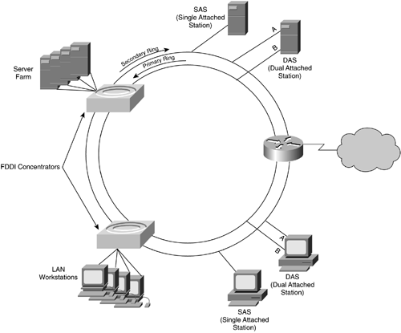
Topology
Designers normally constructed FDDI rings in a network topology such as a "dual ring of trees".
A small number of devices, typically infrastructure devices such as routers rather than host computers, were "dual-attached" to both rings.

Slide 37
Host computers then connected as single-attached devices to the routers or FDDI concentrators.
The dual ring in its most degenerate form simply collapses into a single device.
Typically, a computer-room contained the whole dual ring,
some implementations deployed FDDI as a metropolitan area network.

Slide 38
the dual ring actually passes through each connected device and requires each such device to remain continuously operational
The standard actually allows for optical bypasses, but network engineers consider these unreliable
minicomputers are not suitable for connection to the dual ring (As they are not under the control of N/W engineers.).

Slide 39
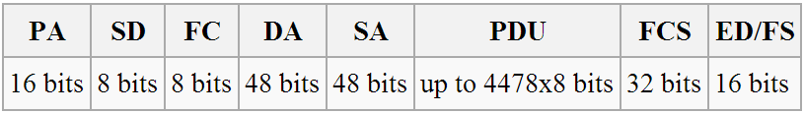
Frame format
Where PA is the preamble, SD is a start delimiter, FC is frame control, DA is the destination address, SA is the source address, PDU is the protocol data unit(or packet data unit), FCS is the frame check Sequence (or checksum), andED/FS are the end delimiter and frame status

Slide 40
Ethernet vs. Token Ring: Media Access Control Methods
Contention (Ethernet)
performs better than token passing on low utilization LANs
high utilization - collisions and retransmission when 2 stations try to communicate simultaneously
Token passing
high utilization - superior performance, no collisions
QoS – multimedia preference to some applications
used to control bus in USB, Firewire, and other emerging shared media technologies

Slide 41
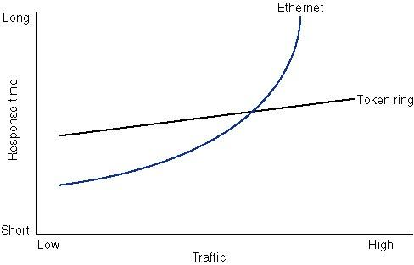
Ethernet vs. Token Ring: Response Time vs. Load

